Slide 1
Algorithms and Data Structures
Gabriel Istrate, University of Bucharest
Course 0: Heapsort, Lower bounds.
Slide credit (partial): David Luebke (Virginia)

Slide 2
Sorting Revisited
So far: two algorithms to sort an array of numbers
  What is the advantage of merge sort?
  What is the advantage of insertion sort?
Next on the agenda: Heapsort
  Combines advantages of both previous algorithms

Slide 3
Heaps
A heap can be seen as a complete binary tree:
  What makes a binary tree complete?
  Is the example above complete?
16
14
10
8
7
9
3
2
4
1

Slide 4
Heaps
A heap can be seen as a complete binary tree:
  The book calls them “nearly complete” binary trees; can think of unfilled slots as null pointers
16
14
10
8
7
9
3
2
4
1
1
1
1
1
1

Slide 5
Heaps
In practice, heaps are usually implemented as arrays:
16
14
10
A =
16
14
10
8
7
9
3
2
4
1
=
8
7
9
3
2
4
1

Slide 6
Heaps
To represent a complete binary tree as an array:
  The root node is A[1]
  Node i is A[i]
  The parent of node i is A[i/2] (note: integer divide)
  The left child of node i is A[2i]
  The right child of node i is A[2i + 1]
16
14
10
A =
16
14
10
8
7
9
3
2
4
1
=
8
7
9
3
2
4
1

Slide 7
Referencing Heap Elements
So…
  Parent(i) { return ⎣i/2⎦; }
  Left(i) { return 2*i; }
  right(i) { return 2*i + 1; }
An aside: How would you implement this
most efficiently?
Another aside: Really?

Slide 8
The Heap Property
Heaps also satisfy the heap property:
A[Parent(i)] ≥ A[i] for all nodes i > 1
  In other words, the value of a node is at most the value of its parent
  Where is the largest element in a heap stored?
Definitions:
  The height of a node in the tree = the number of edges on the longest downward path to a leaf
  The height of a tree = the height of its root

Slide 9
Heap Height
What is the height of an n-element heap? Why?
This is nice: basic heap operations take at most time proportional to the height of the heap

Slide 10
Heap Operations: Heapify()
Heapify(): maintain the heap property
  Given: a node i in the heap with children l and r
  Given: two subtrees rooted at l and r, assumed to be heaps
  Problem: The subtree rooted at i may violate the heap property (How?)
  Action: let the value of the parent node “float down” so subtree at i satisfies the heap property
    What do you suppose will be the basic operation between i, l, and r?

Slide 11
Heap Operations: Heapify()
Heapify(A, i)
{
l = Left(i); r = Right(i);
if (l <= heap_size(A) && A[l] > A[i])
largest = l;
else
largest = i;
if (r <= heap_size(A) && A[r] > A[largest])
largest = r;
if (largest != i)
Swap(A, i, largest);
Heapify(A, largest);
}

Slide 12
Heapify() Example
16
4
10
14
7
9
3
2
8
1
A =
16
4
10
14
7
9
3
2
8
1

Slide 13
Heapify() Example
16
4
10
14
7
9
3
2
8
1
A =
16
4
10
14
7
9
3
2
8
1

Slide 14
Heapify() Example
16
4
10
14
7
9
3
2
8
1
A =
16
4
10
14
7
9
3
2
8
1

Slide 15
Heapify() Example
16
14
10
4
7
9
3
2
8
1
A =
16
14
10
4
7
9
3
2
8
1

Slide 16
Heapify() Example
16
14
10
4
7
9
3
2
8
1
A =
16
14
10
4
7
9
3
2
8
1

Slide 17
Heapify() Example
16
14
10
4
7
9
3
2
8
1
A =
16
14
10
4
7
9
3
2
8
1

Slide 18
Heapify() Example
16
14
10
8
7
9
3
2
4
1
A =
16
14
10
8
7
9
3
2
4
1

Slide 19
Heapify() Example
16
14
10
8
7
9
3
2
4
1
A =
16
14
10
8
7
9
3
2
4
1

Slide 20
Heapify() Example
16
14
10
8
7
9
3
2
4
1
A =
16
14
10
8
7
9
3
2
4
1

Slide 21
Analyzing Heapify(): Informal
Aside from the recursive call, what is the running time of Heapify()?
How many times can Heapify() recursively call itself?
What is the worst-case running time of Heapify() on a heap of size n?

Slide 22
Analyzing Heapify(): Formal
Fixing up relationships between i, l, and r takes Θ(1) time
If the heap at i has n elements, how many elements can the subtrees at l or r have?
  Draw it
Answer: 2n/3 (worst case: bottom row 1/2 full)
So time taken by Heapify() is given by
T(n) ≤ T(2n/3) + Θ(1)

Slide 23
Analyzing Heapify(): Formal
So we have
T(n) ≤ T(2n/3) + Θ(1)
By case 2 of the Master Theorem,
T(n) = O(lg n)
Thus, Heapify() takes linear time

Slide 24
Heap Operations: BuildHeap()
We can build a heap in a bottom-up manner by running Heapify() on successive subarrays
  Fact: for array of length n, all elements in range
  A[⎣n/2⎦ + 1 .. n] are heaps (Why?)
  So:
    Walk backwards through the array from n/2 to 1, calling Heapify() on each node.
    Order of processing guarantees that the children of node i are heaps when i is processed

Slide 25
BuildHeap()
// given an unsorted array A, make A a heap
BuildHeap(A)
{
heap_size(A) = length(A);
for (i = ⎣length[A]/2⎦ downto 1)
Heapify(A, i);
}

Slide 26
BuildHeap() Example
Work through example
A = {4, 1, 3, 2, 16, 9, 10, 14, 8, 7}
4
1
3
2
16
9
10
14
8
7

Slide 27
Analyzing BuildHeap()
Each call to Heapify() takes O(lg n) time
There are O(n) such calls (specifically, ⎣n/2⎦)
Thus the running time is O(n lg n)
  Is this a correct asymptotic upper bound?
  Is this an asymptotically tight bound?
A tighter bound is O(n)
  How can this be? Is there a flaw in the above reasoning?

Slide 28
Analyzing BuildHeap(): Tight
To Heapify() a subtree takes O(h) time where h is the height of the subtree
  h = O(lg m), m = # nodes in subtree
  The height of most subtrees is small
Fact: an n-element heap has at most ⎡n/2^{h+1}⎤ nodes of height h
CLR 7.3 uses this fact to prove that BuildHeap() takes O(n) time

Slide 29
Heapsort
Given BuildHeap(), an in-place sorting algorithm is easily constructed:
  Maximum element is at A[1]
  Discard by swapping with element at A[n]
    Decrement heap_size[A]
    A[n] now contains correct value
  Restore heap property at A[1] by calling Heapify()
  Repeat, always swapping A[1] for A[heap_size(A)]

Slide 30
Heapsort
Heapsort(A)
{
BuildHeap(A);
for (i = length(A) downto 2)
{
Swap(A[1], A[i]);
heap_size(A) -= 1;
Heapify(A, 1);
}
}

Slide 31
Analyzing Heapsort
The call to BuildHeap() takes O(n) time
Each of the n - 1 calls to Heapify() takes O(lg n) time
Thus the total time taken by HeapSort()
= O(n) + (n - 1) O(lg n)
= O(n) + O(n lg n)
= O(n lg n)

Slide 32
Priority Queues
Heapsort is a nice algorithm, but in practice Quicksort (coming up) usually wins
But the heap data structure is incredibly useful for implementing priority queues
  A data structure for maintaining a set S of elements, each with an associated value or key
  Supports the operations Insert(), Maximum(), and ExtractMax()
  What might a priority queue be useful for?

Slide 33
Priority Queue Operations
Insert(S, x) inserts the element x into set S
Maximum(S) returns the element of S with the maximum key
ExtractMax(S) removes and returns the element of S with the maximum key
How could we implement these operations using a heap?

Slide 34
Sorting So Far
Insertion sort:
  Easy to code
  Fast on small inputs (less than ~50 elements)
  Fast on nearly-sorted inputs
  O(n²) worst case
  O(n²) average (equally-likely inputs) case
  O(n²) reverse-sorted case

Slide 35
Sorting So Far
Merge sort:
  Divide-and-conquer:
    Split array in half
    Recursively sort subarrays
    Linear-time merge step
  O(n lg n) worst case
  Doesn’t sort in place

Slide 36
Sorting So Far
Heap sort:
  Uses the very useful heap data structure
    Complete binary tree
    Heap property: parent key > children’s keys
  O(n lg n) worst case
  Sorts in place
  Fair amount of shuffling memory around

Slide 37
Sorting So Far
Quick sort:
  Divide-and-conquer:
    Partition array into two subarrays, recursively sort
    All of first subarray < all of second subarray
    No merge step needed!
  O(n lg n) average case
  Fast in practice
  O(n²) worst case
    Naïve implementation: worst case on sorted input
    Address this with randomized quicksort

Slide 38
How Fast Can We Sort?
We will provide a lower bound, then beat it
  How do you suppose we’ll beat it?
First, an observation: all of the sorting algorithms so far are comparison sorts
  The only operation used to gain ordering information about a sequence is the pairwise comparison of two elements
  Theorem: all comparison sorts are Ω(n lg n)
    A comparison sort must do O(n) comparisons (why?)
    What about the gap between O(n) and O(n lg n)

Slide 39
Decision Trees
Decision trees provide an abstraction of comparison sorts
  A decision tree represents the comparisons made by a comparison sort. Every thing else ignored
  (Draw examples on board)
What do the leaves represent?
How many leaves must there be?

Slide 40
Decision Trees
Decision trees can model comparison sorts. For a given algorithm:
  One tree for each n
  Tree paths are all possible execution traces
  What’s the longest path in a decision tree for insertion sort? For merge sort?
What is the asymptotic height of any decision tree for sorting n elements?
Answer: Ω(n lg n) (now let’s prove it…)

Slide 41
Lower Bound For
Comparison Sorting
Thm: Any decision tree that sorts n elements has height Ω(n lg n)
What’s the minimum # of leaves?
What’s the maximum # of leaves of a binary tree of height h?
Clearly the minimum # of leaves is less than or equal to the maximum # of leaves

Slide 42
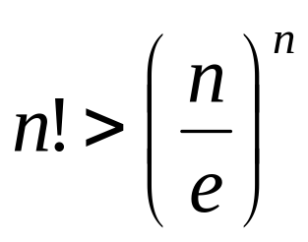
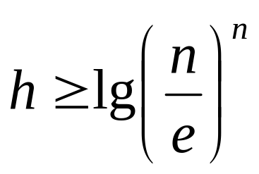
Lower Bound For
Comparison Sorting
So we have…
n! ≤ 2^{h}
Taking logarithms:
lg (n!) ≤ h
Stirling’s approximation tells us:
Thus:

Slide 43
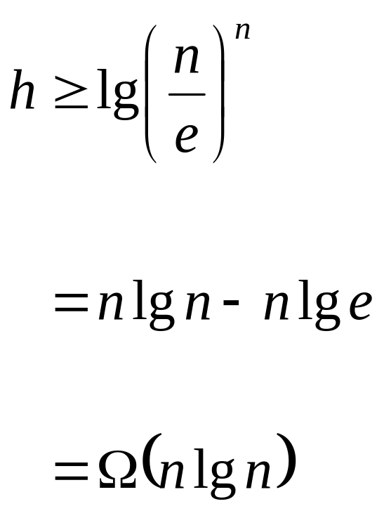
Lower Bound For
Comparison Sorting
So we have
Thus the minimum height of a decision tree is Ω(n lg n)

Slide 44
Lower Bound For
Comparison Sorts
Thus the time to comparison sort n elements is Ω(n lg n)
Corollary: Heapsort and Mergesort are asymptotically optimal comparison sorts
  How can we do better than Ω(n lg n)?

